Slide 1
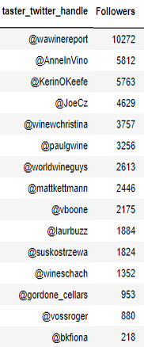
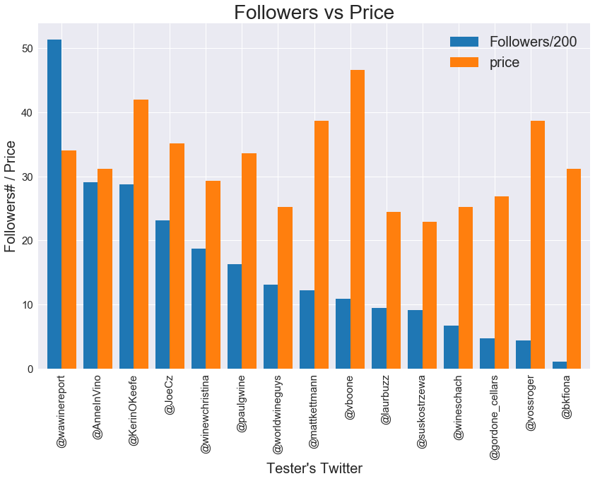
Reviewed by Tasters with Massive Following does NOT mean Higher Price

Slide 2
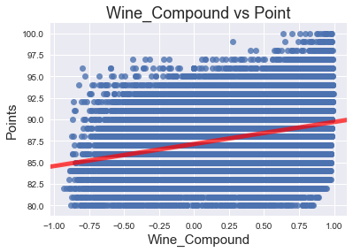
There is Correlation between Wine Description and Review Points

Slide 3
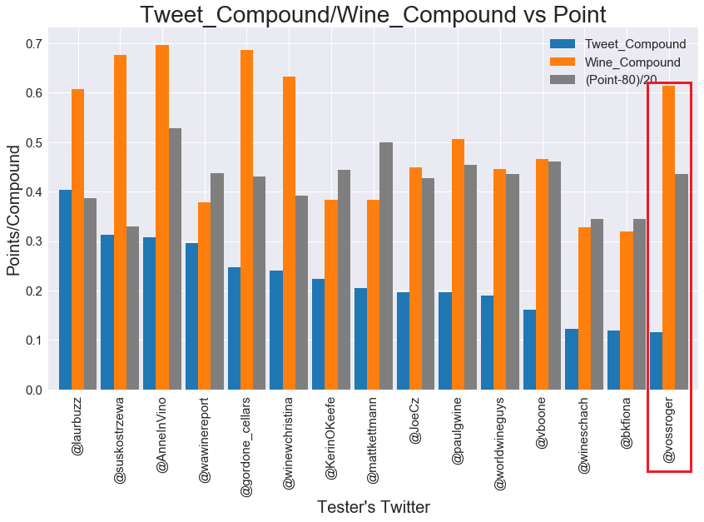
All Tasters’ Twitter have POSITIVE sentiment score.
All Tasters’ Wine Description sentiment score are even HIGHER than tasters’ twitter sentiment score.
For some tasters: Good Wine Descriptions do NOT always correspond with Points

Slide 4

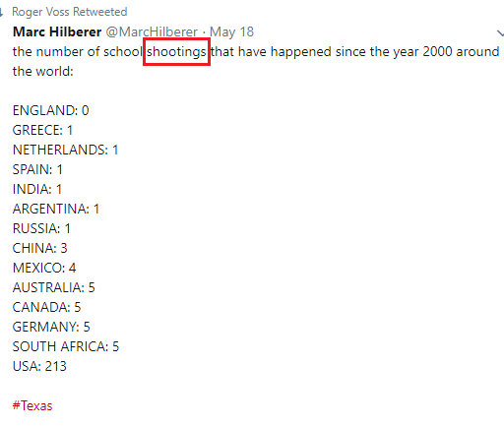
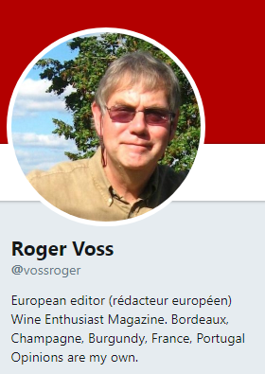


Twitter Posts:
Wine Descriptions:
A year in wood and 30 months in bottle before release have allowed this attractive wine to fully develop its solid yet smooth texture. It has concentration, layers of bright
Somewhat lean, this has a tart, grapefruit character that sits awkwardly with the otherwise fresh, green fruit character. Hard-edged.
Full, firm white wine that gives good green fruit and pear flavors, lifted with spice from wood. The wine is round, while still retaining crispness from grassy acidity, and offers a good depth of plum skin structure and flavor.

Slide 5
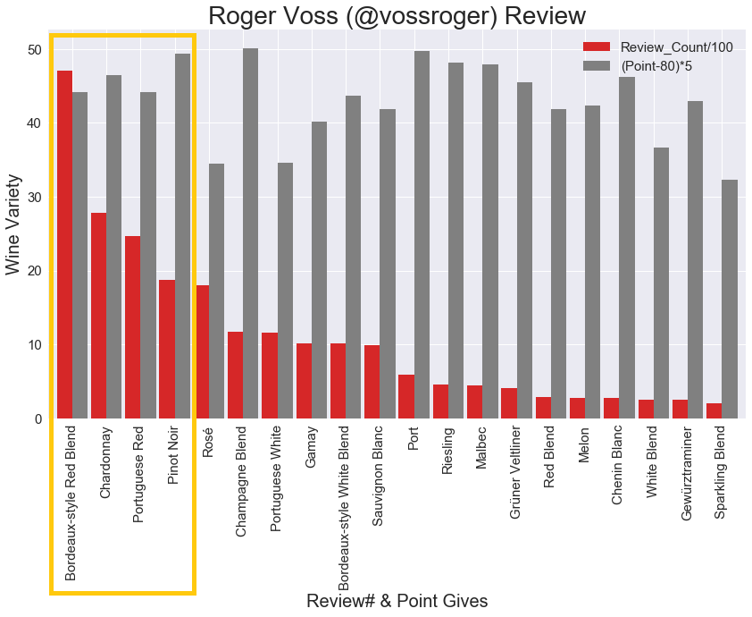



Slide 6

Who else will be a better Taster, if chosen by Winery?
Very Positive Wine Sentiment Score
High Wine Review Point
Large Twitter Follower Base

Slide 7
